Slide 1


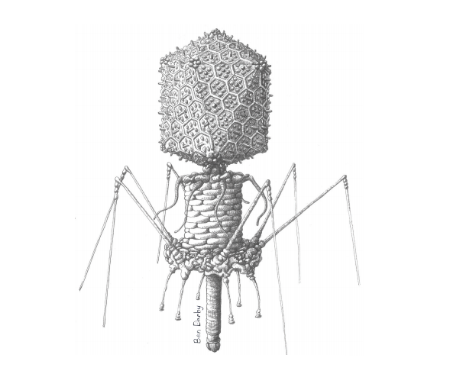
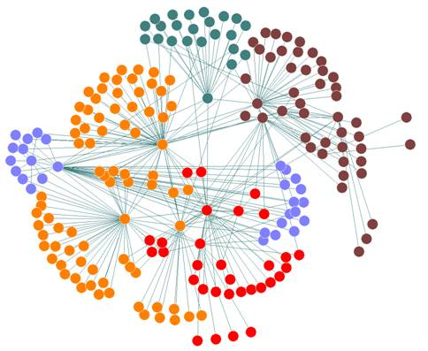
Dr. Richard Allen White III Washington State University FABI Workshop - Oct 21, 2018

Slide 2
Learning Objectives
Brief introduction of me and my research
Learn about ‘Omics,’ technology terms
Introduction to multiomics
History of genome sequencing
Introduction to sequencing technologies
Unix/Linux command line
Grep -> text wrangling
Github
R intro
R ggplot2 intro

Slide 3

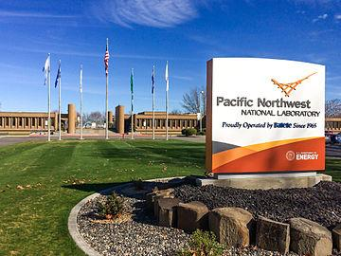
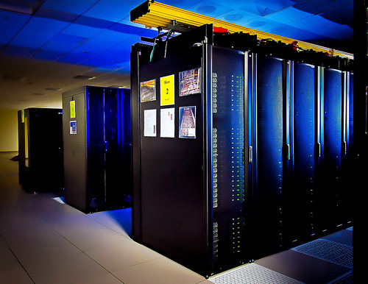
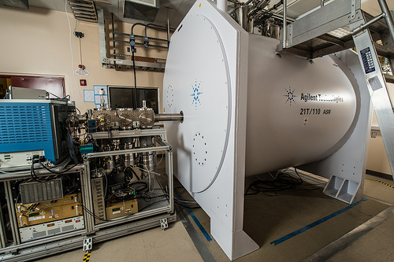
Introduction - Dr. RAWIII

Slide 4
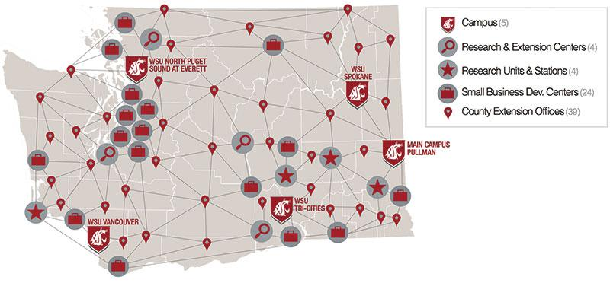
Introduction - Dr. RAWIII

Slide 5
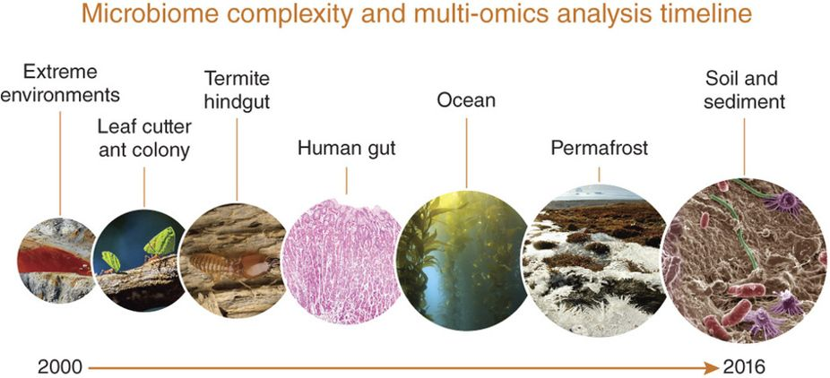
Research - Dr. RAWIII
White III et al., 2016. Nature Protocols Link to article:https://www.nature.com/articles/nprot.2016.148

Slide 6
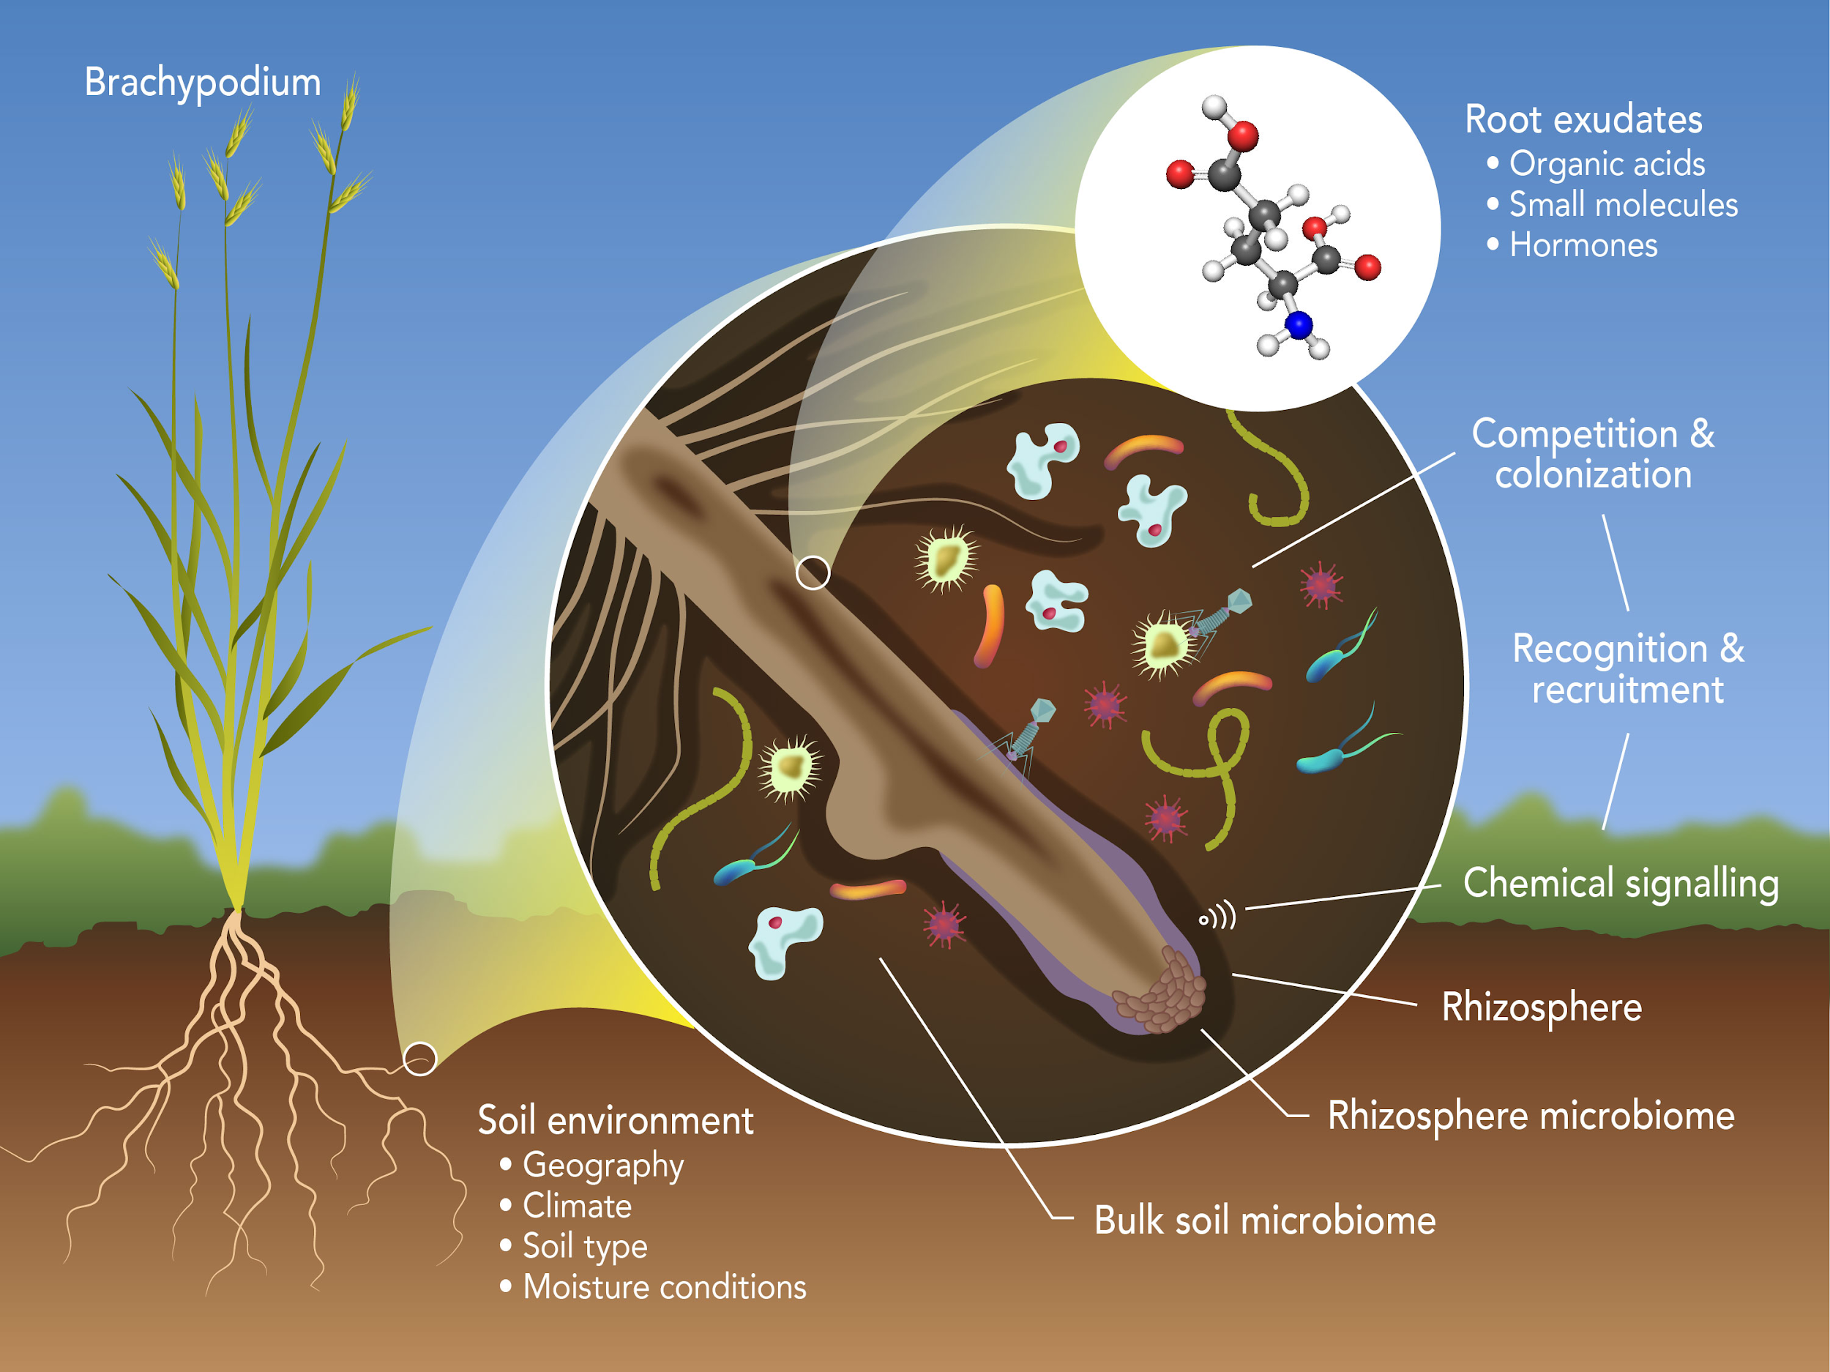
Research - Dr. RAWIII
Link to article:https://www.sciencedirect.com/science/article/pii/S2452219817300666

Slide 7
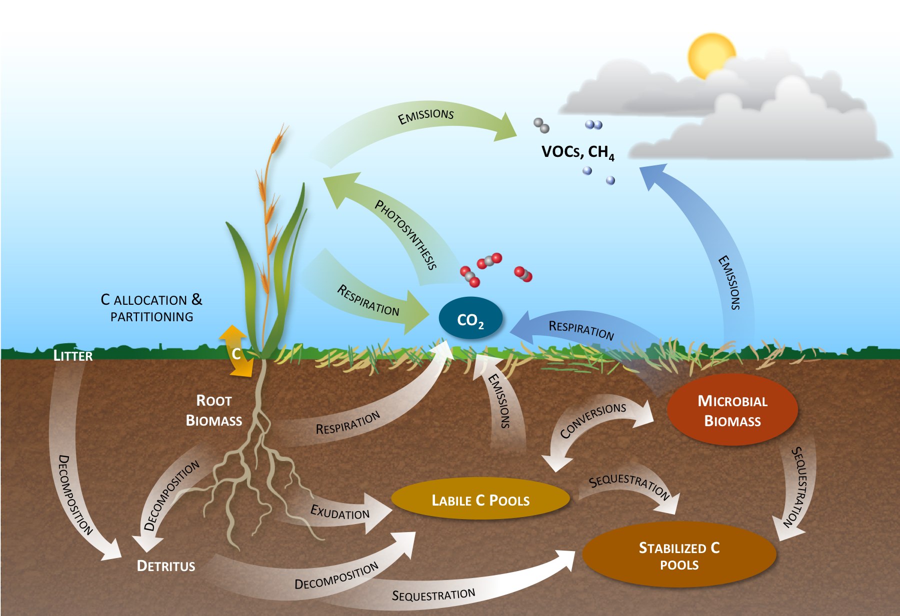
Research - Dr. RAWIII
Link to article:https://www.sciencedirect.com/science/article/pii/S24522198173004596

Slide 8
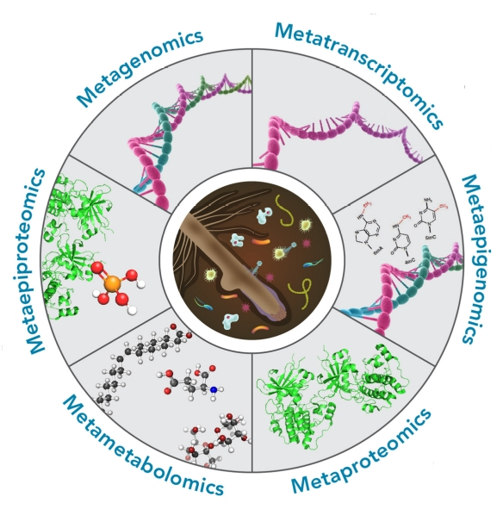
Omics terms
White III et al., 2017 Rhizosphere Link to article: https://www.sciencedirect.com/science/article/pii/S2452219817300666#f0015

Slide 9
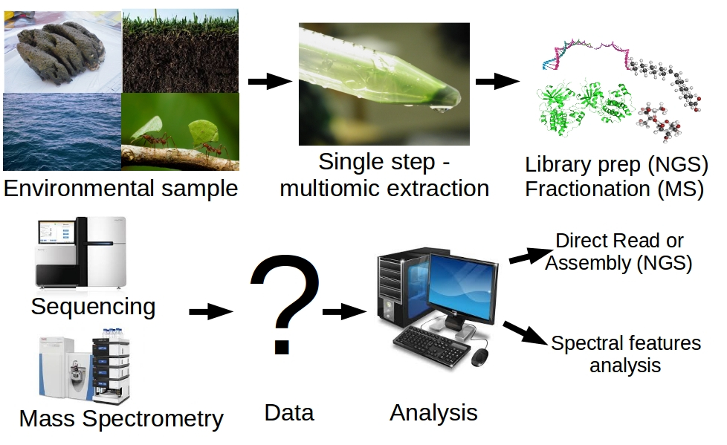
A workflow of a multiomic study
White III et al., 2016. Nature Protocols Link to article:https://www.nature.com/articles/nprot.2016.148

Slide 10
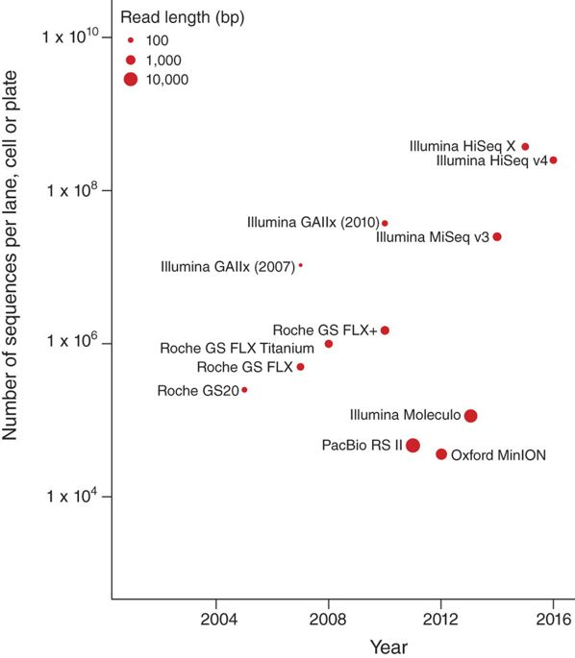
Sequencing technologies
White III et al., 2016. Nature Protocols Link to article:https://www.nature.com/articles/nprot.2016.148

Slide 11
History of genome sequenced
1972 - First gene to be sequenced was MS2 coat protein (510 bp) 1976 - First RNA genome sequenced was Bacteriophage MS2 (3.56 kb) 1977 - First DNA genome sequenced was Bacteriophage phiX174 (5.38 kb) 1979 - First plasmid to be sequenced was pBR322 (4.3 kb) 1984 - First mammalian DNA virus sequenced was Epstein-Barr virus (172 kb) 1992 - First chromosome sequenced was Yeast chromosome III (315 kb) 1995 - First cellular genome sequenced was Hemophilus influenzae (1.8 Mb) 1995 - First archaeal genome sequenced was Methanococcus jannaschii (1.7 Mb) 1996 - First eukaryotic genome sequenced was Saccharomyces cerevisiae (12 MB) 1998 - First multicellular organism sequenced was Ceanorhabditis elegans (97 Mb) 2000 - First plant genome sequenced was Arabidopsis thaliana (125 Mb) 2001 - First mammalian draft genome Homo sapiens (3.3 Gb)
Super bonus -> Who sequenced the first cellular genome?

Slide 12
Data format
*.fna, .fasta, .fa ?
*.faa ?
*.gff ?
*.gbk ?
*.fq or fastq ?
*.gtf ?
Read vs. sequence?
Contig?
kmer?

Slide 13
What is Unix?
A multi-task and multi-user Operating System
Developed in 1969 at AT&T’s Bell Labs by: Ken Thompson (Unix) Dennis Ritchie (C) Douglas Mcllroy (Pipes)
Some other variants: System V, Solaris, SCO Unix, SunOS, 4.4BSD, FreeBSD, NetBSD, OpenBSD, BSDI

Slide 14
What is Linux?
A clone of Unix Developed in 1991 by Linus Torvalds, a Finnish graduate student Inspired by and replacement of Minix Linus' Minix became Linux Consist of : Linux Kernel GNU (GNU is Not Unix) Software Software Package management Others

Slide 15
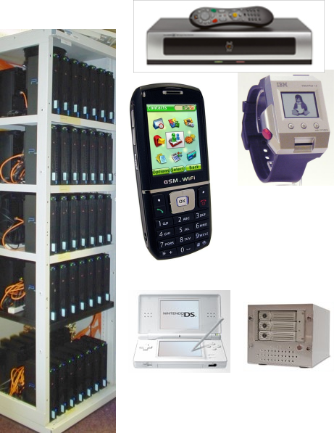
What is Linux?
Originally developed for 32-bit x86-based PC Ported to other architectures, eg.
-> Alpha, VAX, PowerPC, IBM S/390, MIPS, IA-64 PS2, TiVo, cellphones, watches, Nokia N810, NDS, routers, NAS, GPS, …

Slide 16
What is Linux?
> 300 Linux Distributions
Ubuntu (Best for newbies, my fav, South African!)
Slackware
Redhat RHEL (commercially support)
Fedora (free)
CentOS (free RHEL, based in England)
Debian (one of the few called GNU/Linux)
Knoppix (first LiveCD distro.) …

Slide 17
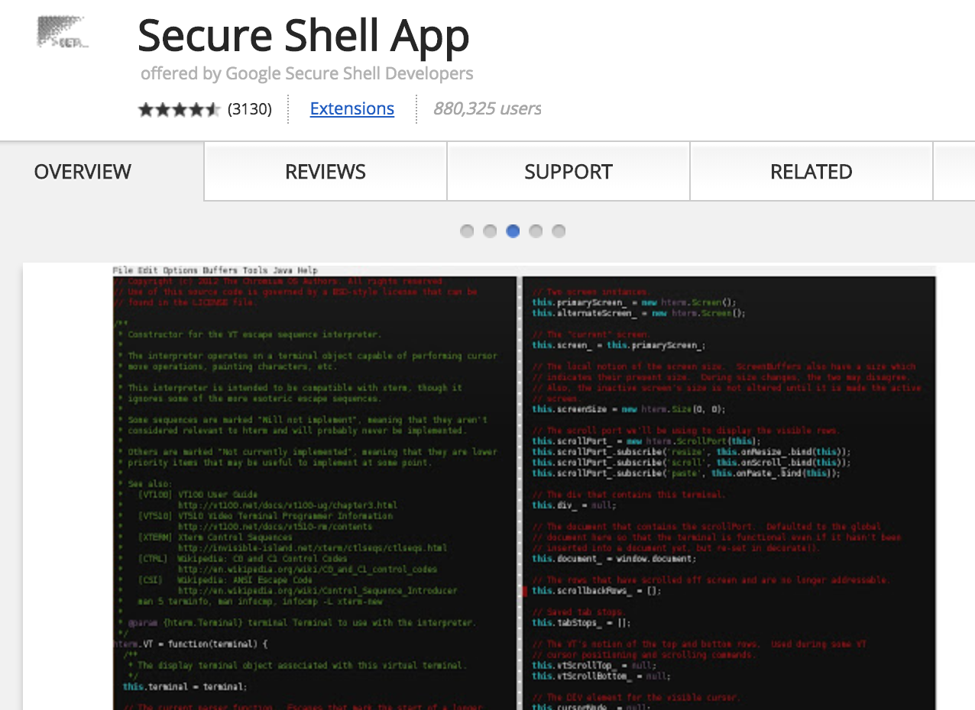
Terminal for Unix/Bash
Mac: Terminal
Windows: PUTTY
Chrome: Secure Shell (extension; runs command line in your browser! How cool is that?)

Slide 18
Unix/Bash tutorial
>>Master page
https://github.com/raw937/FABI_workshop
https://github.com/raw937/FABI_workshop/blob/master/bin/Bash_tutorial.md

Slide 19
Command line review
cd ? tar ?
pwd ? scp ?
mkdir ? rm ?
head ? rm -r ?
tail ? echo ?
more ? | ?
less ? > ?
mv ? < ?
touch ? >> ?
cp ? cat ?

Slide 20
Unix/Bash - check point
Make a folder with your name
Make two files in as .txt (labeled 1 and 2)
Write your name in file 1
Write your name in file 2 with _a at the end
Combine those two files to a new file
Copy the whole folder of your name with a new name

Slide 21
Grep “the hand of the gods”
https://github.com/raw937/FABI_workshop/blob/master/bin/grep_tutorial.md

Slide 22
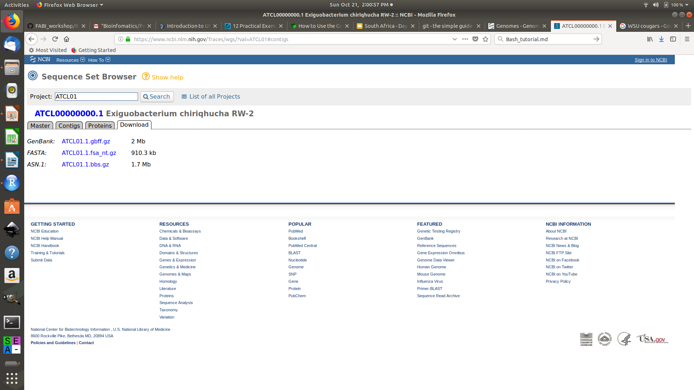
Grep “the hand of the gods”
https://www.ncbi.nlm.nih.gov/Traces/wgs/?val=ATCL01#contigs

Slide 23
Grep “the hand of the gods”
Download fasta file
Unzip the file
Rename file to “.fasta”
Give me the number of lines
Tell me the size of the file in bytes
Count the number of sequences using a command
Export all the headers into a new “.txt” file

Slide 24
Git tutorial
Make an account
https://github.com/
Follow tutorial on
https://github.com/raw937/FABI_workshop/edit/master/bin/git%20tutorial.md

Slide 25
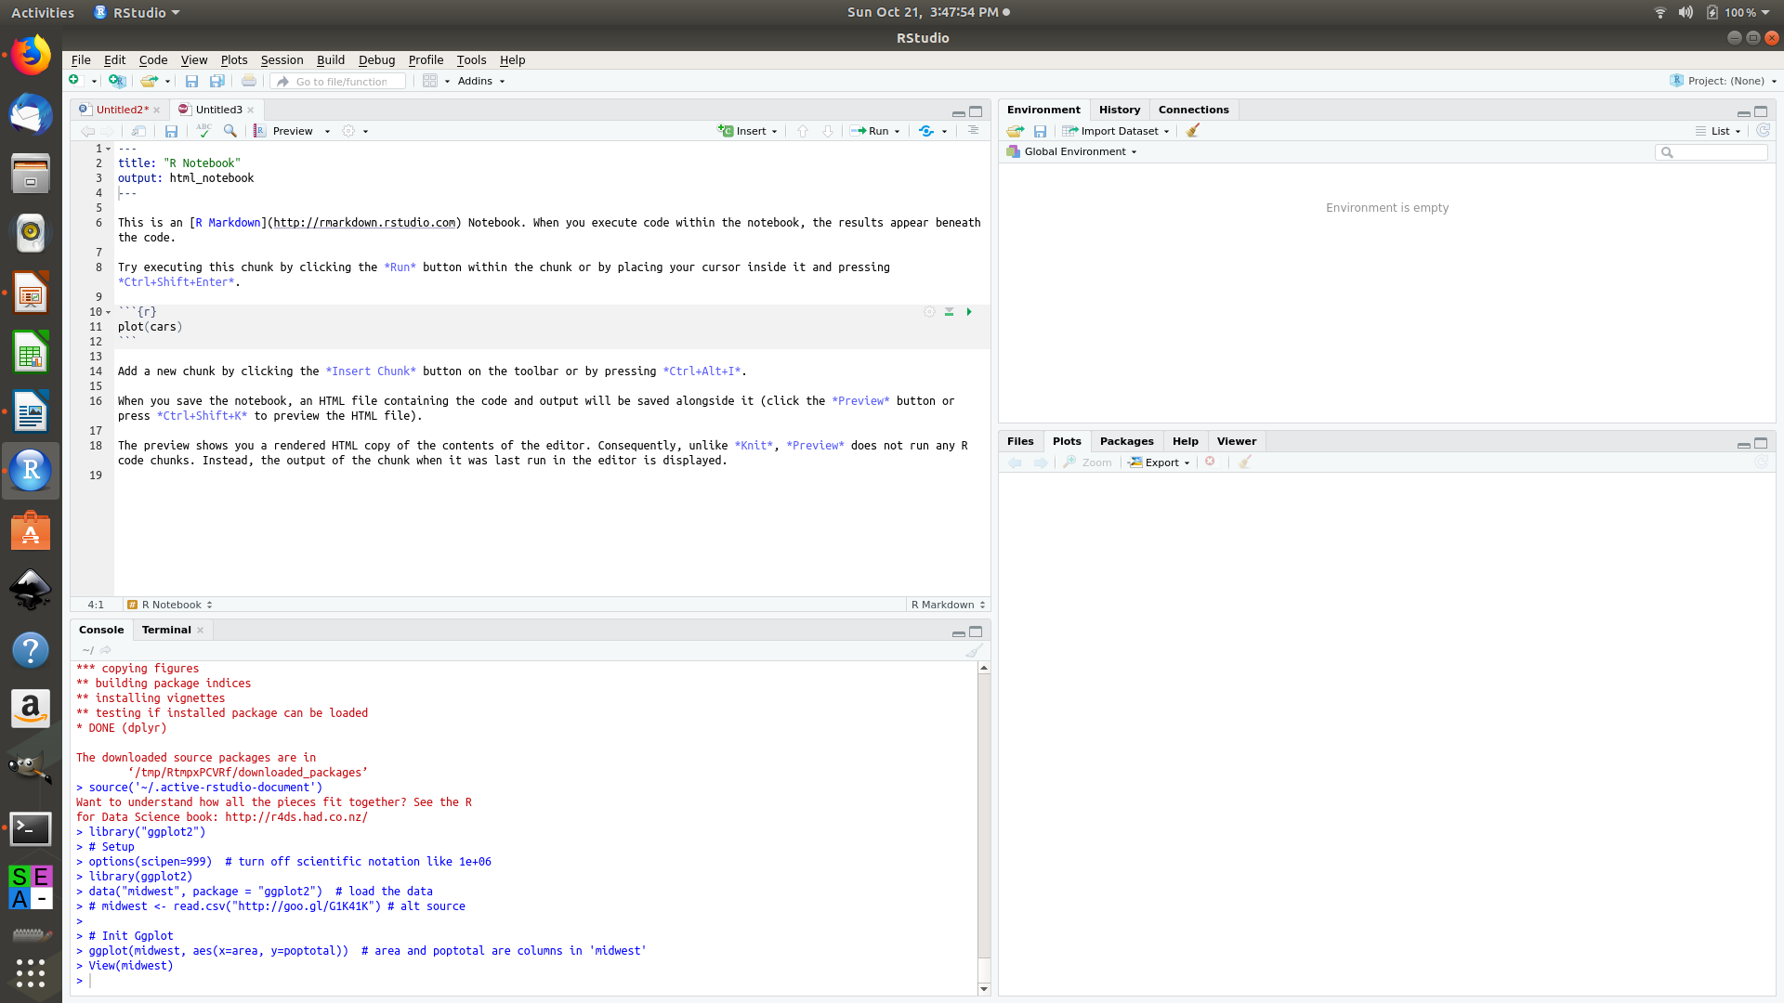
R, Rstudio and Rnotebooks
Install Rstudio
https://www.rstudio.com/products/rstudio/download/

Slide 26
R, Rstudio and Rnotebooks
Try executing this chunk by clicking the *Run* button within the chunk or by placing your cursor inside it and pressing *Ctrl+Shift+Enter*.
Add a new chunk by clicking the *Insert Chunk* button on the toolbar or by pressing *Ctrl+Alt+I*.
When you save the notebook, an HTML file containing the code and output will be saved alongside it (click the *Preview* button or press *Ctrl+Shift+K* to preview the HTML file).
The preview shows you a rendered HTML copy of the contents of the editor. Consequently, unlike *Knit*, *Preview* does not run any R code chunks. Instead, the output of the chunk when it was last run in the editor is displayed.

Slide 27
R, Rstudio and Rnotebooks
https://github.com/raw937/FABI_workshop/blob/master/bin/ggplot_tutorial.Rmd
VIEW ON SCREEN (HTML)
.

Slide 28
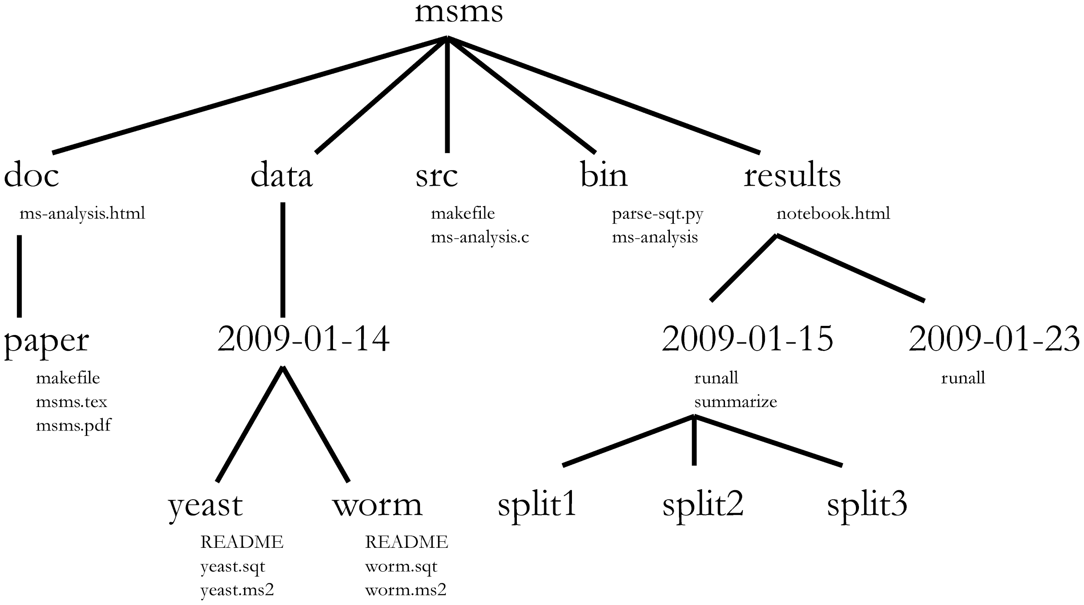
Reproducible research
Noble, 2009 Link to article:https://journals.plos.org/ploscompbiol/article?id=10.1371/journal.pcbi.1000424

Slide 29
Reproducible research
http://joey711.github.io/phyloseq-demo/Restroom-Biogeography.html

